Slide 1
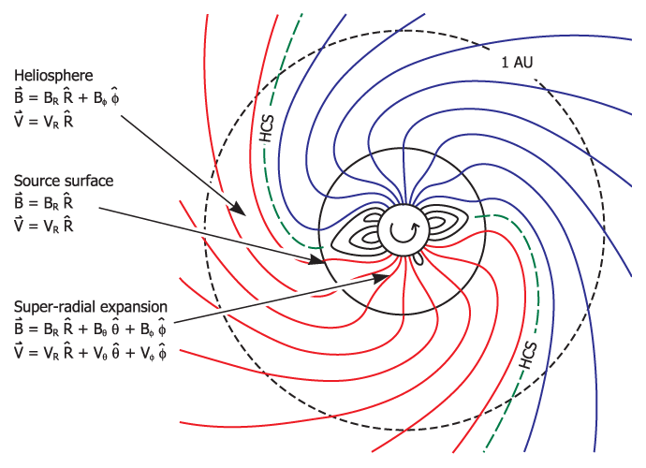
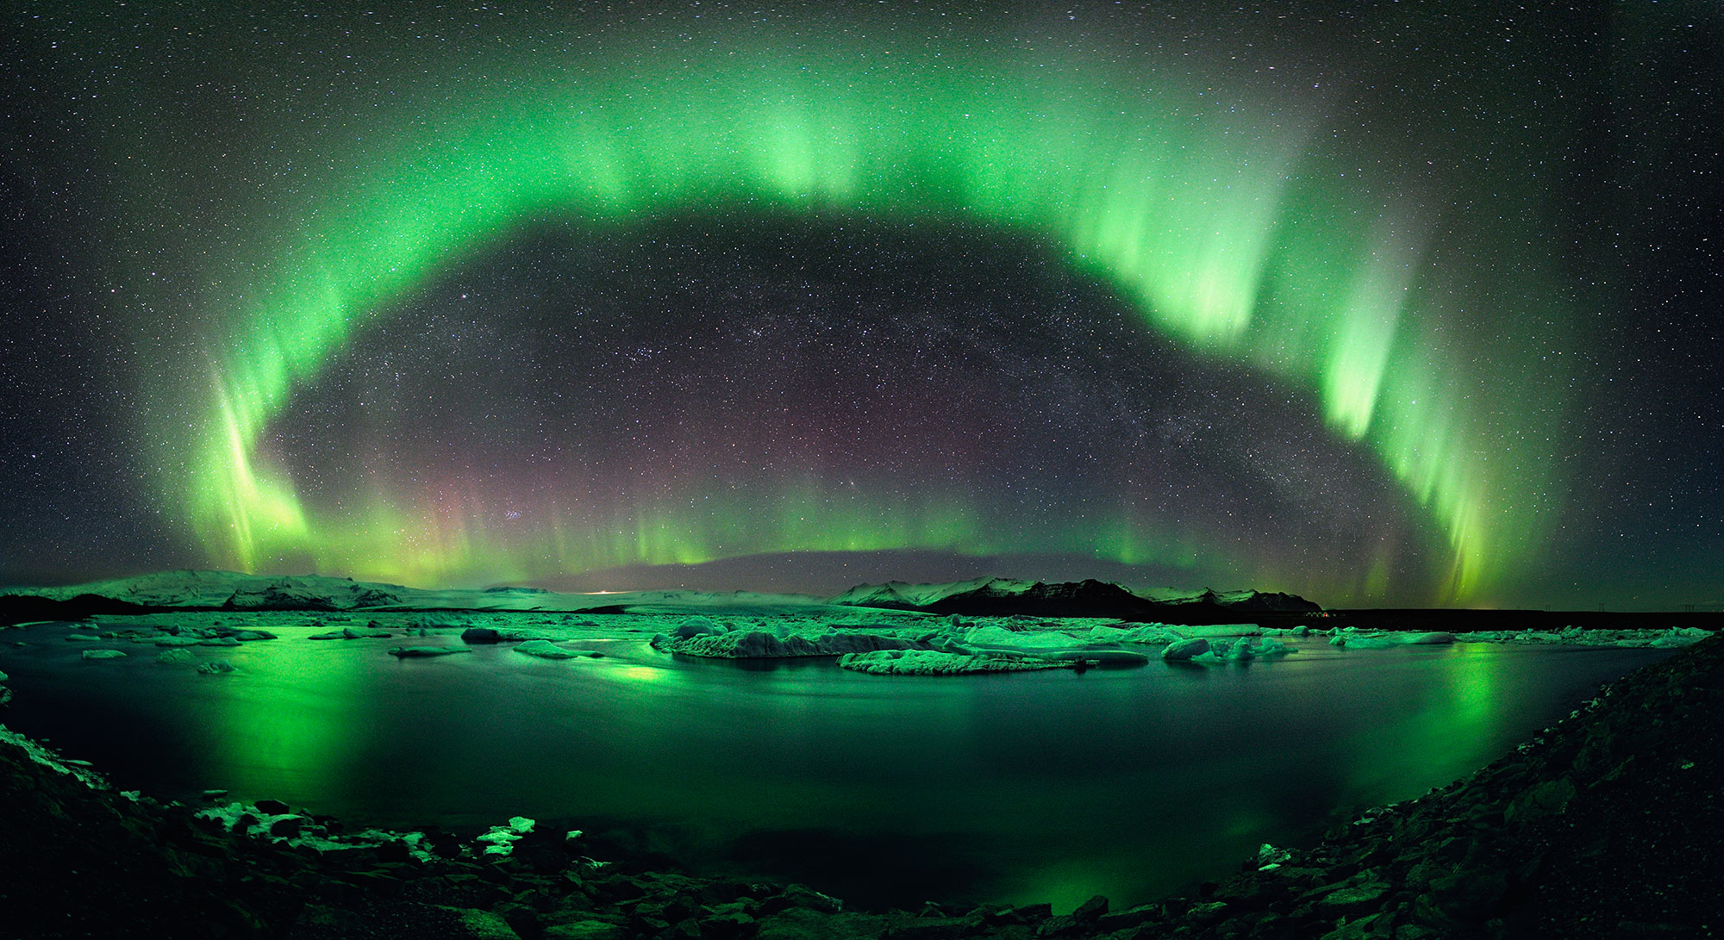
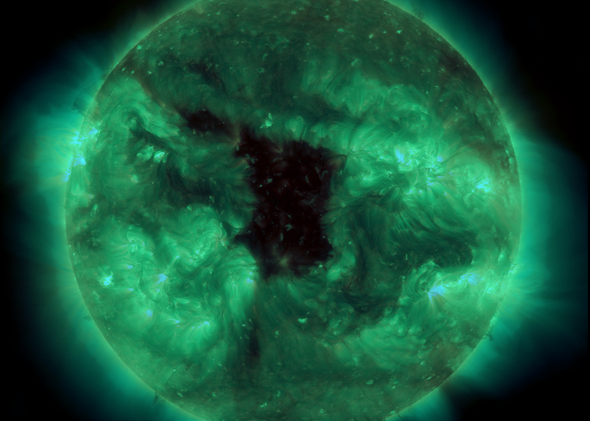
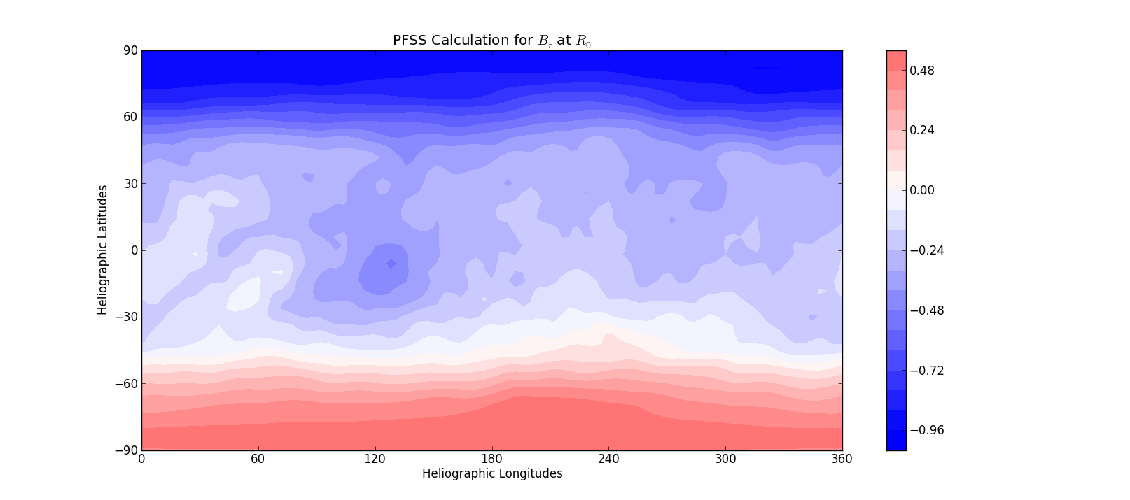
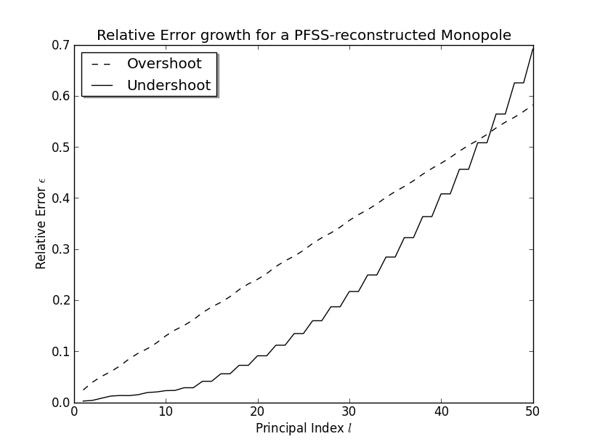
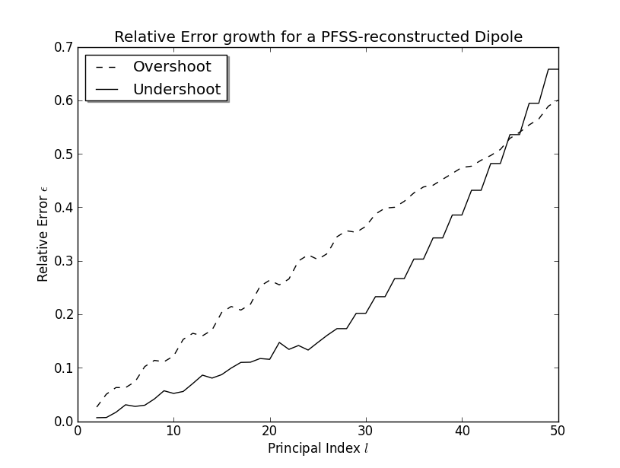
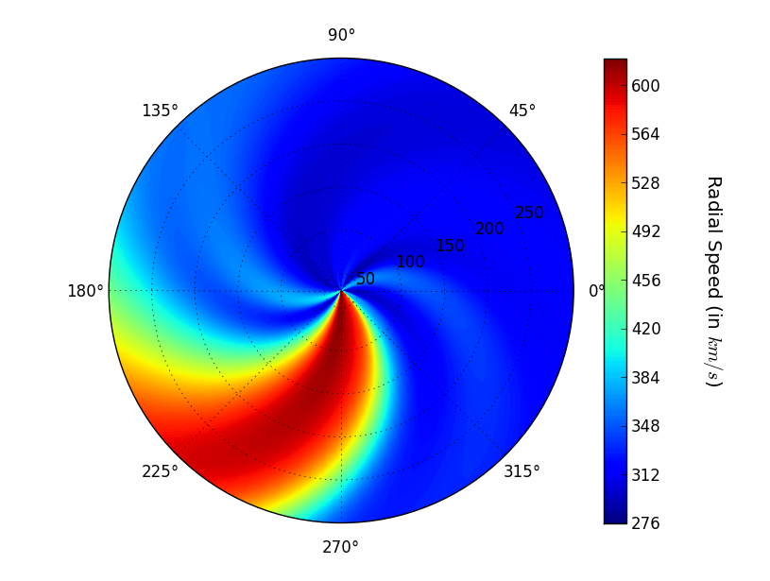
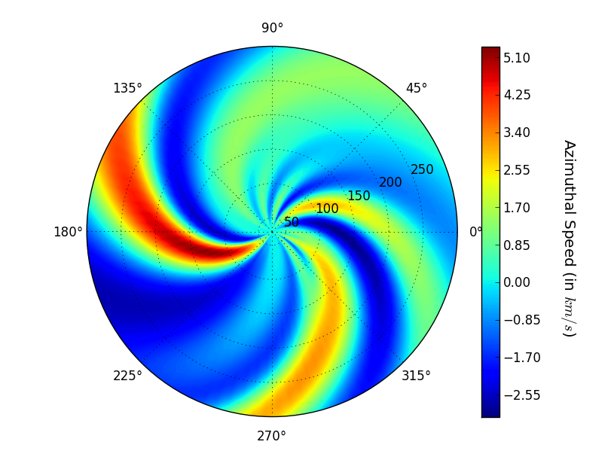
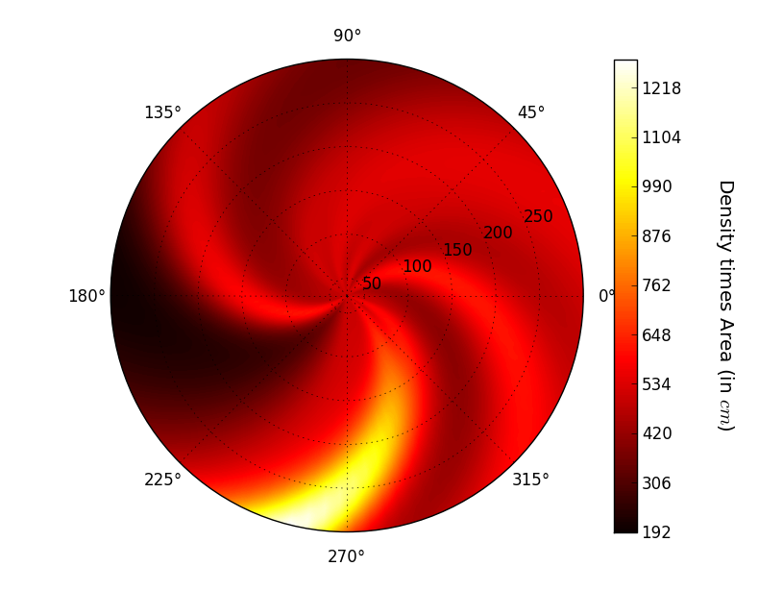
Solar Wind Modeling
CHARM-PROJECT
Pieters Michael
Belgian Institute for Space Aeronomy, Avenue Circulaire 3, B-1180 Brussels, Belgium
Although Parker was the first to describe the solar wind successfully at the time, his elegant theory still masks a number of fundamental problems. The debate how the solar wind is accelerated and why the solar corona is so ‘hot’, is still in full swing. Nevertheless this does not seem to hamper solar wind modeling which has become increasingly more complex as is the picture of the solar wind itself.
A general, simplified strategy for modeling the solar wind is given. Since data near the Sun is scarce: models need to extract their initial conditions from magnetograms and/or white-light coronagraphs.
Not only does the Sun radiate light of different frequencies, it also blows out huge bubbles of supersonic plasma, engulfing all planets and a host of other bodies, shaping their environment. Solar wind related phenomena include geomagnetic storms on Earth, aurora and comet plasma tails.
Solar Magnetic Field Structure
Interplanetary space is separated by a source surface into two regions: the corona and the heliosphere. Within the source surface, the solar magnetic field controls the plasma flow. Outside, the magnetic field only plays a minor role in the dynamics.
The corona is modeled by a potential field source surface-model (PFSS) that takes magnetograms as initial condition. The magnetic field is reconstructed with associated Legendre polynomials through a least-squared approach.
The heliospheric solar wind is determined by applying a non-conservative discretisation scheme to the Euler equations with a gravity source in a rotating frame. The stepsize is taken sufficiently small to mimimize mass conservation errors.
Abstract
Introduction
General Methods
M.J. Owens & R.J. Forsyth, Living Reviews Solar Phys.,10 (2013)
Reconstruction of the magnetic field at the solar surface, with 30 harmonics, for Carrington Rotation 2073 by using a GONG synoptic map.
Why not classic PFSS?
PURPOSE:
Calculation of the solar magnetic field might give an idea of the location of coronal holes and the streamer belt. Coronal holes are darker regions where the magnetic fieldlines are open and hence the solar wind can flow unimpeded.
In the streamer belt the magnetic fieldlines are closed.
Coronal Holes: Fast Speed & Low Density
Streamer Belt: Slow Speed & High Density
Coronal Model
Simulation of a steady solar wind propagating through the heliosphere. Due to solar rotation the wind twists into an Archimedean spiral.
The variability of the solar wind causes regions of compression and rarefaction. The magnetic fieldlines are dragged out by the solar wind.
Constructing a HCCSSS-model to take into account the horizontal current sheet and to better reproduce the magnetic fieldlines as spotted in coronographs. Incorporating a variable source surface.
Adopting a conservative implicit upwind method for modeling the hydrodynamics through the heliosphere. Such a method tends to capture shocks better if source terms are present in the transport equations. Additional refinements will be integrated (collisionless heat flux).
Finding suitable relationships between the output of coronal models and initial conditions to drive the heliospheric solar wind.
The dream: model can be used as a nowcast and forecast and can then be coupled to ionospheric and plasmaspheric models to predict geomagnetic storms.
Heliospheric Model
Goals

